Slide 2
Industrial Project

Slide 3
Introduction
Janardanswami Yogabhyasi Mandal

Slide 4

Introduction
Janardanswami Yogabhyasi Mandal

Slide 5
Problem Statement
Introduction
Janardanswami Yogabhyasi Mandal

Slide 6
Problem Statement
This organization provides books for sale which are currently sold only via their center at Ram Nagar and through postal services. This current approach is non-scalable and it is limited to only people from Nagpur mostly, as there is no proper way for people outside Nagpur to buy the books

Slide 7
Solution
Problem Statement

Slide 8
Solution
Problem Statement
The process of designing, developing, and deploying an e-commerce website that allows consumers in faraway places to purchase books with only an internet connection and a working web browser..

Slide 9
Design
Problem Statement
Solution
Use Case Diagram

Slide 10
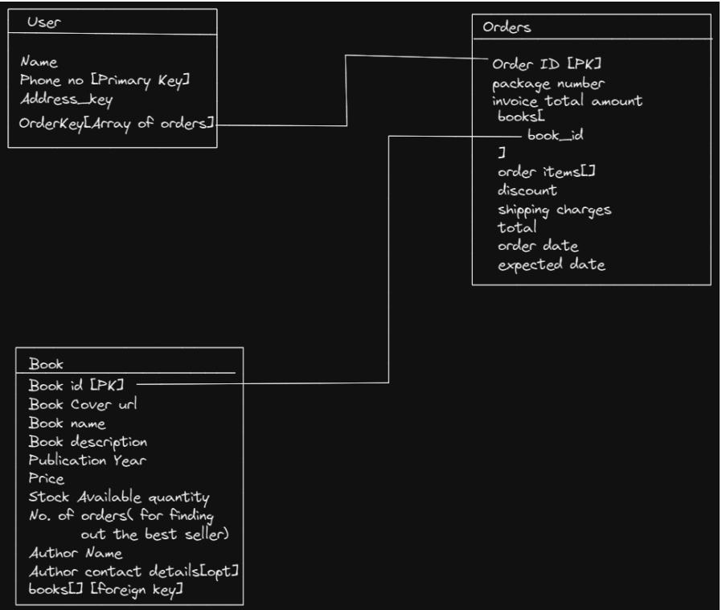
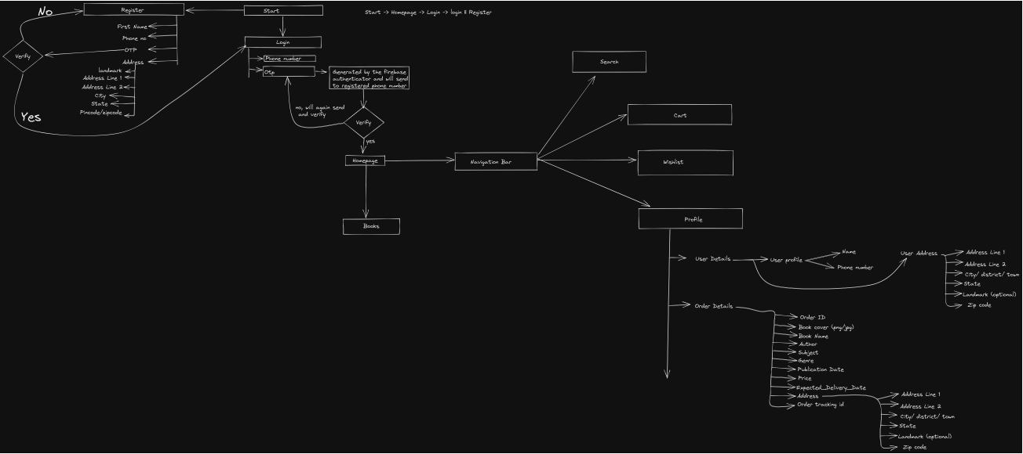
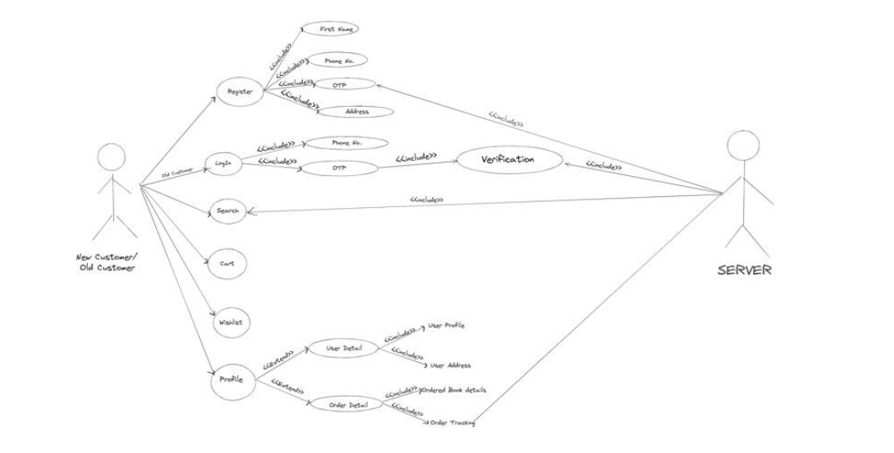
Design
Problem Statement
Solution
Flow Diagram
Use Case Diagram
Database Diagram

Slide 11
Technical Specifications
Problem Statement
Design
Solution

Slide 12
Technical Specifications
Problem Statement
Design
Solution
HTML
CSS
JavaScript
TailwindCSS
VueJS
Visual Studio Code
Firebase
NoSQL
Git & GitHub

Slide 13
Colour Palette
Technical Specifications
Problem Statement
Design
Solution

Slide 14
Colour Palette
Technical Specifications
Problem Statement
Design
Solution
60%
30%
10%
60/30/10 Rule

Slide 15
UI Designs
Technical Specifications
Colour Palette
Problem Statement
Design
Solution

Slide 16
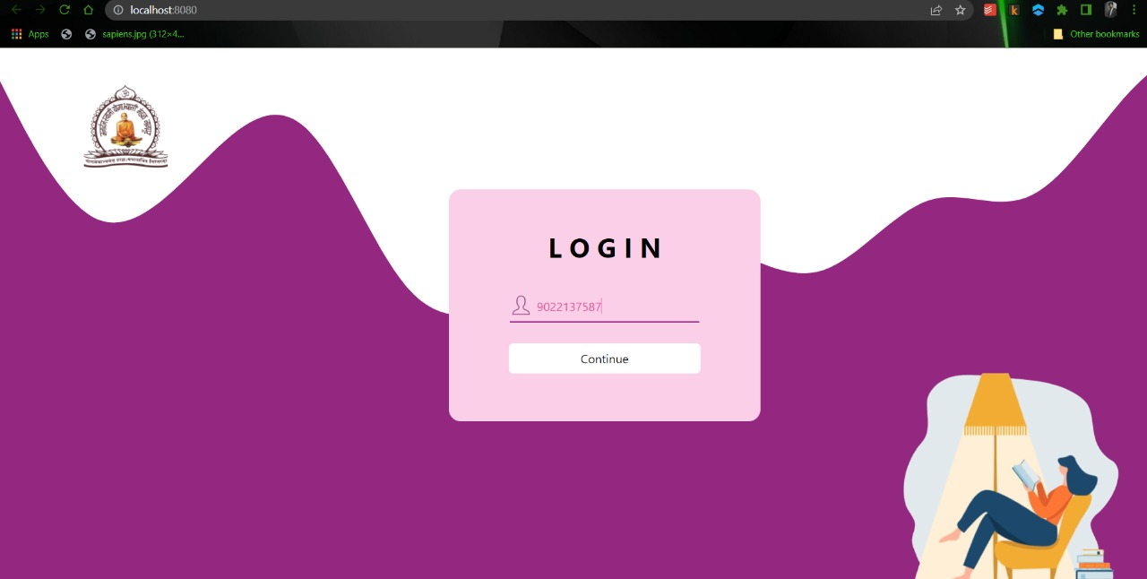
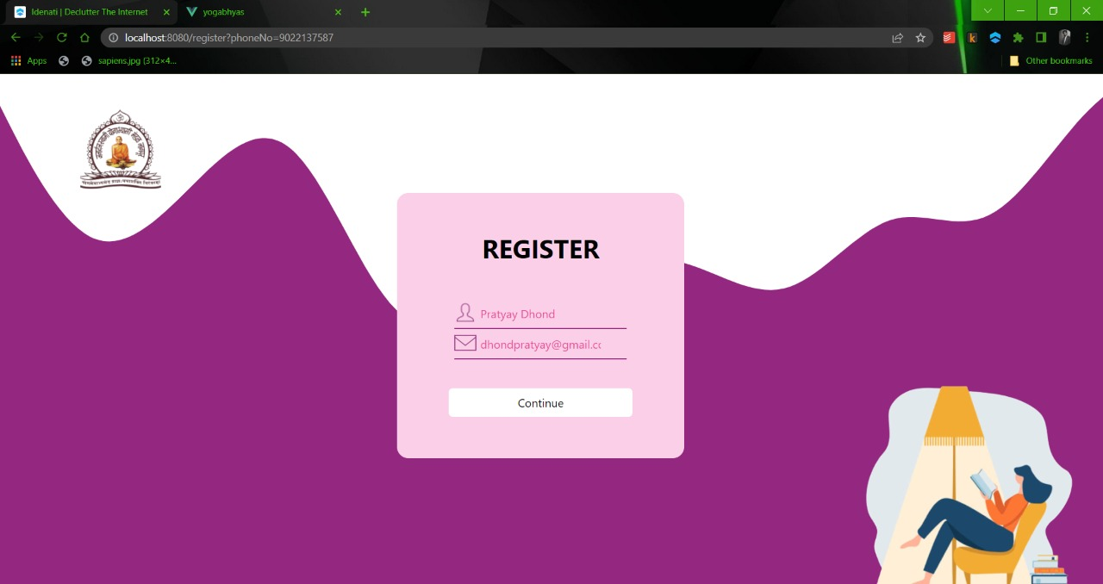
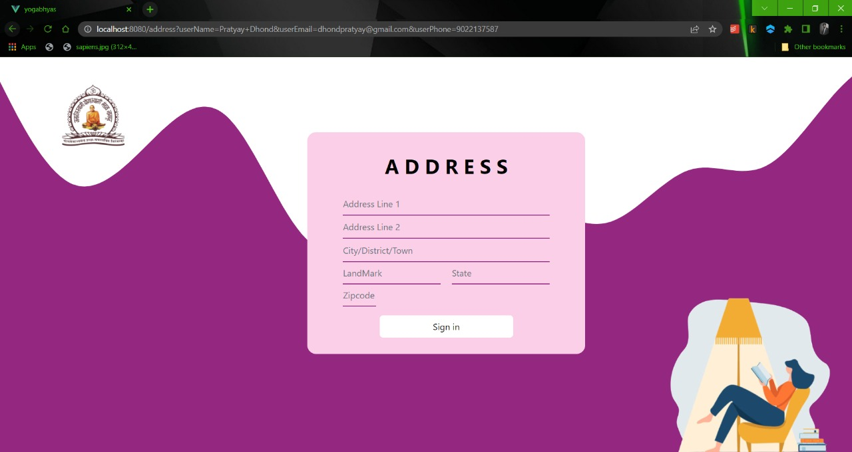
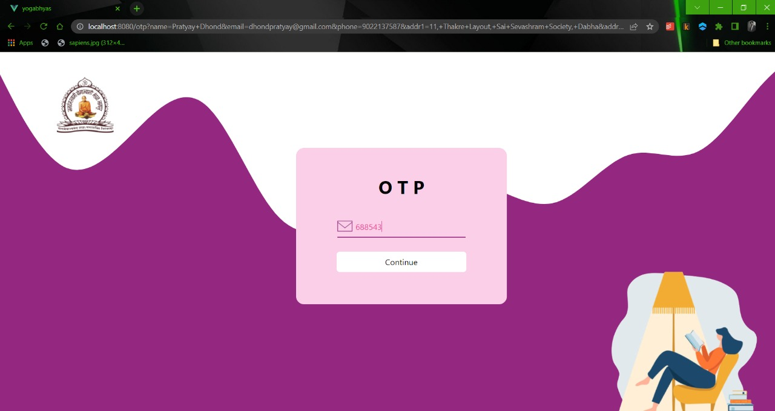
UI Designs
Technical Specifications
Colour Palette
Problem Statement
Design
Solution

Slide 17
UI Designs
Technical Specifications
Colour Palette
Problem Statement
Design
Solution

Slide 18
UI Designs
Technical Specifications
Colour Palette
Problem Statement
Design
Solution

Slide 19
UI Designs
Technical Specifications
Colour Palette
Problem Statement
Design
Solution

Slide 20
UI Designs
Technical Specifications
Colour Palette
Problem Statement
Design
Solution

Slide 21
UI Designs
Technical Specifications
Colour Palette
Problem Statement
Design
Solution

Slide 22
UI Designs
Technical Specifications
Colour Palette
Problem Statement
Design
Solution

Slide 23
UI Designs
Technical Specifications
Colour Palette
Problem Statement
Design
Solution

Slide 24
UI Designs
Technical Specifications
Colour Palette
Problem Statement
Design
Solution

Slide 25
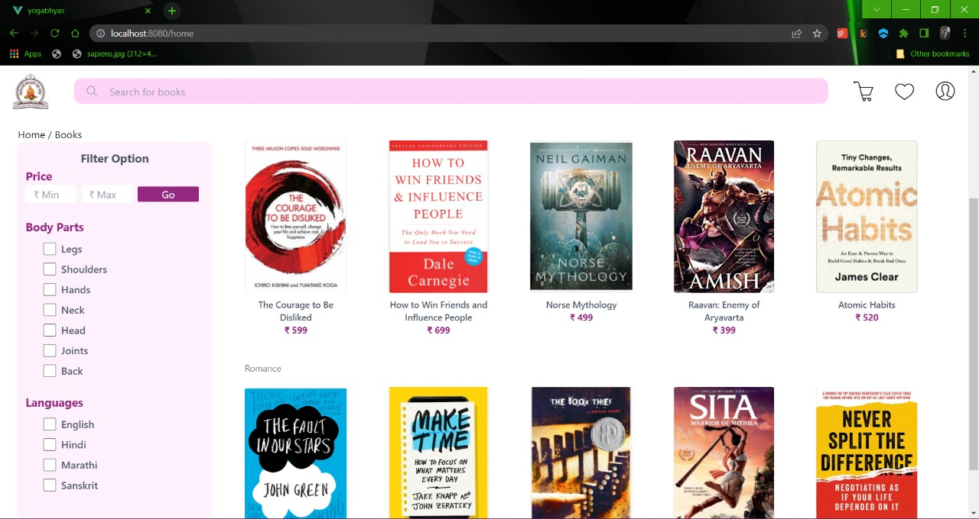
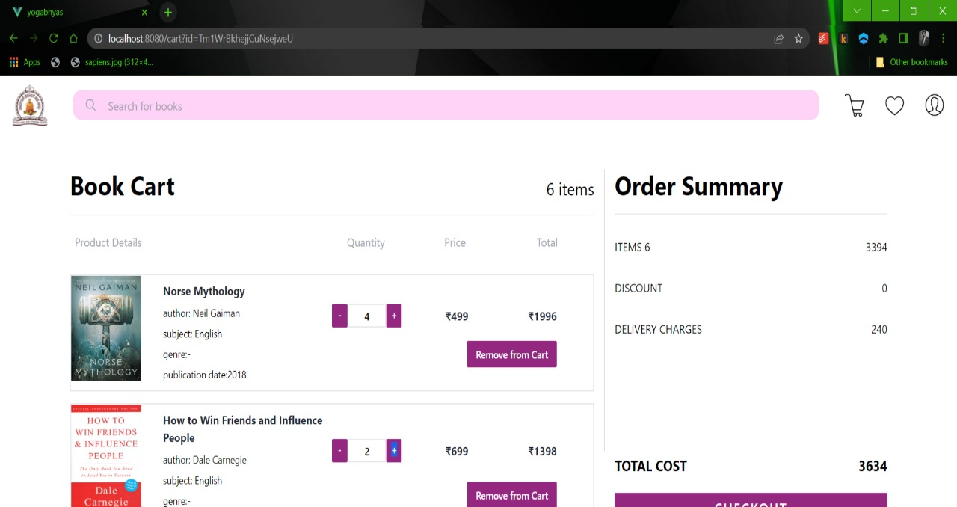
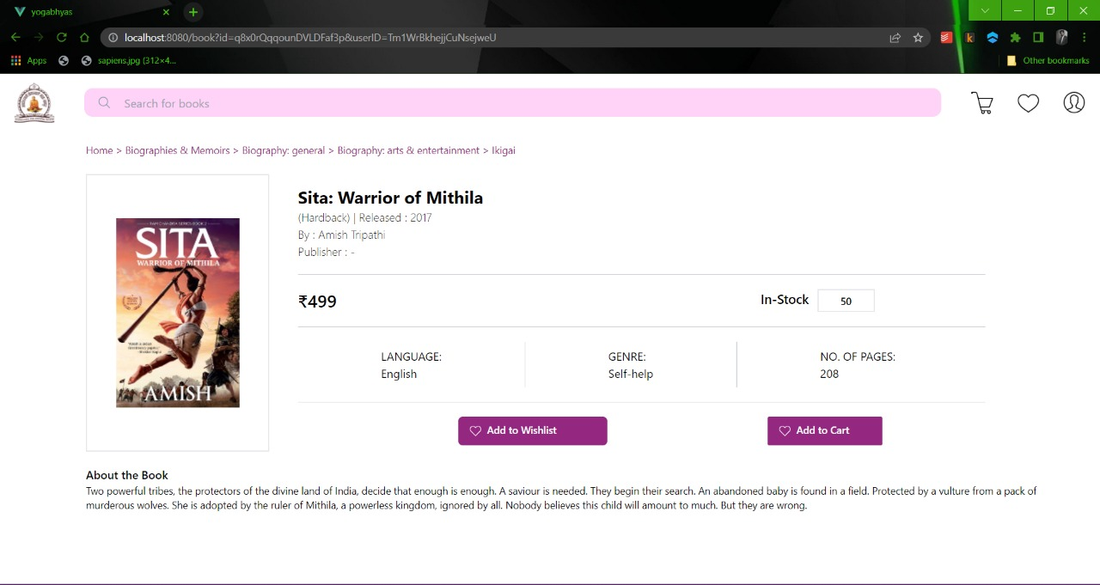
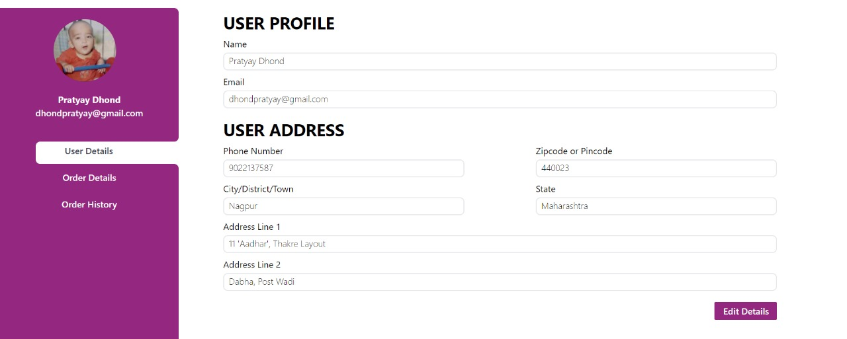
UI Designs
Technical Specifications
Colour Palette
Problem Statement
Design
Solution

Slide 26
UI Designs
Technical Specifications
Colour Palette
Problem Statement
Design
Solution

Slide 27
UI Designs
Technical Specifications
Colour Palette
Problem Statement
Design
Solution

Slide 28
UI Designs
Technical Specifications
Colour Palette
Problem Statement
Design
Solution

Slide 29
UI Designs
Technical Specifications
Colour Palette
Problem Statement
Design
Solution

Slide 30
UI Designs
Technical Specifications
Colour Palette
Problem Statement
Design
Solution

Slide 31
UI Designs
Technical Specifications
Colour Palette
Problem Statement
Design
Solution

Slide 32
UI Designs
Technical Specifications
Colour Palette
Problem Statement
Design
Solution

Slide 33
UI Designs
Technical Specifications
Colour Palette
Problem Statement
Design
Solution

Slide 34
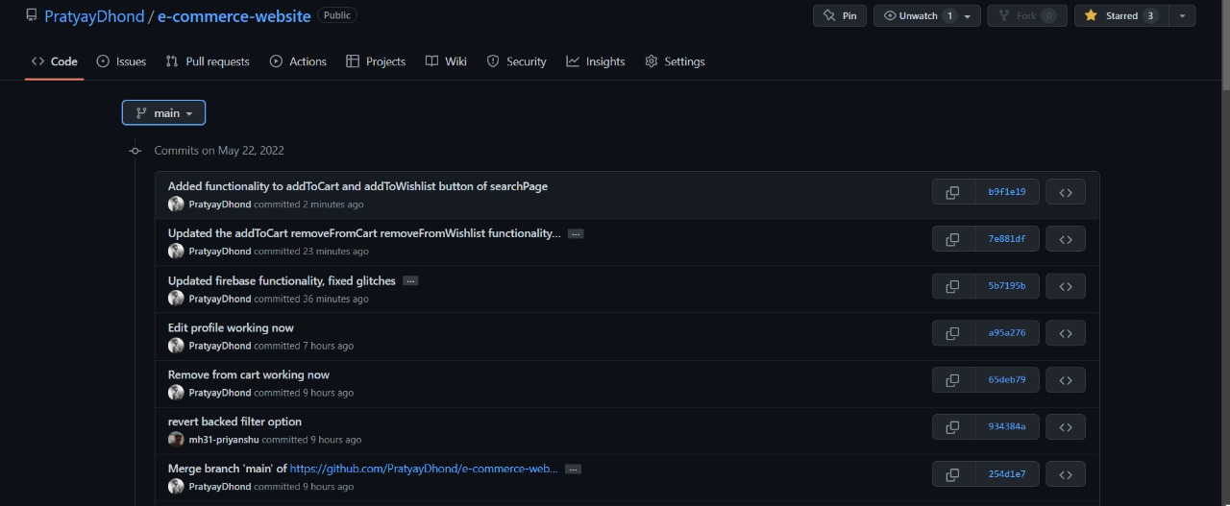
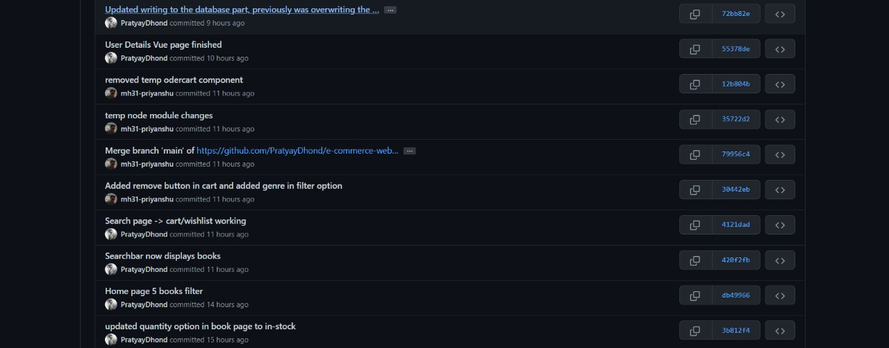
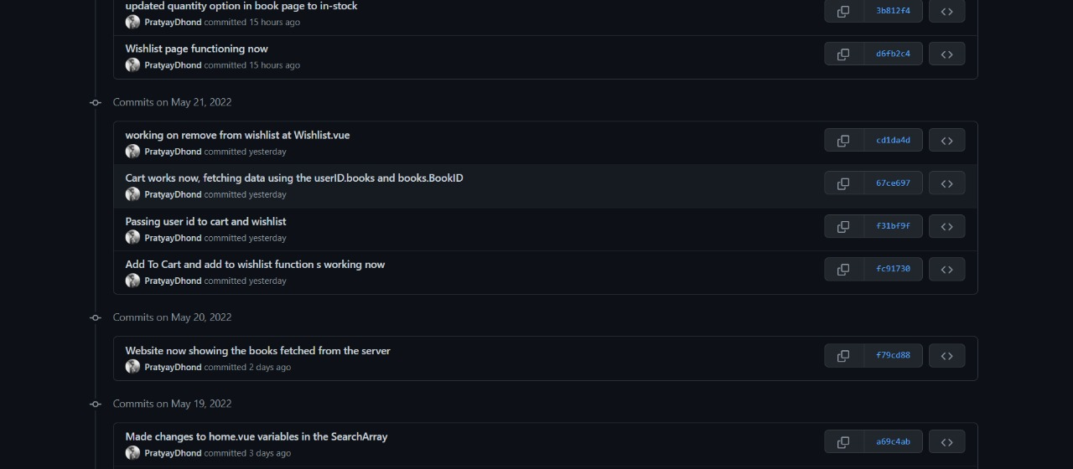
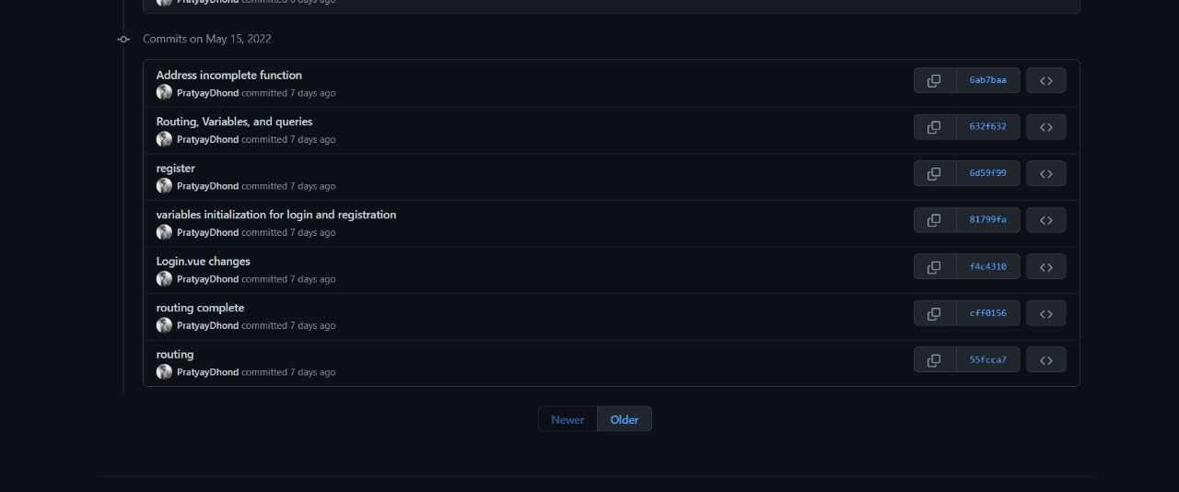
GitHub
Technical Specifications
Colour Palette
Problem Statement
Design
Solution

Slide 35
GitHub
Technical Specifications
Colour Palette
Problem Statement
Design
Solution

Slide 36
GitHub
Technical Specifications
Colour Palette
Problem Statement
Design
Solution

Slide 37
GitHub
Technical Specifications
Colour Palette
Problem Statement
Design
Solution

Slide 38
GitHub
Technical Specifications
Colour Palette
Problem Statement
Design
Solution

Slide 39
GitHub
Technical Specifications
Colour Palette
Problem Statement
Design
Solution

Slide 40
GitHub
Technical Specifications
Colour Palette
Problem Statement
Design
Solution

Slide 41
GitHub
Technical Specifications
Colour Palette
Problem Statement
Design
Solution

Slide 42
GitHub
Technical Specifications
Colour Palette
Problem Statement
Design
Solution

Slide 43
Conclusion
GitHub
Technical Specifications
Colour Palette
UI Designs
Problem Statement
Design
Solution

Slide 44
Conclusion
Technical Specifications
Colour Palette
UI Designs
Problem Statement
Design
Solution
It took several months of tireless efforts from every member of the website team. This project provided an excellent opportunity for teamwork and knowledge of the workplace.

Slide 45

Conclusion
Technical Specifications
Colour Palette
UI Designs
Problem Statement
Design
Solution

